Slide 1
Number recognition from given numbers image
Presented by
Name: Joyanta Dutta
ID: 1402710200740
Batch: 27th
Premier University, Chattogram

Slide 2
Goal
• The main goal of this project is doing easy to get the easy life by using this project.
• Recognizing system of the number from the given numbers image is more helpful to decrease time consuming effort, basically it is pattern matching way to find the number, which is required to find.
• Its aim to build a system to identify the patterns from the given patterns.

Slide 3
Motivation
By using this project, we can get the matched pattern from a numbers template. We can use this project to find the numbers from a template. Now-a-days, we want the easy life. To get this easy life, pattern matching system is so important, it plays the role of finding the pattern, which is required to find out.

Slide 4
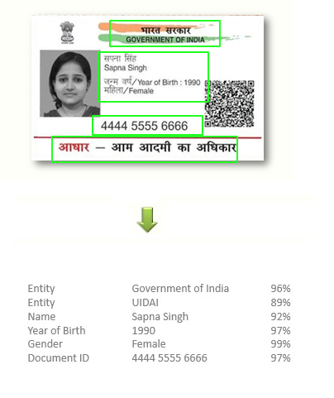
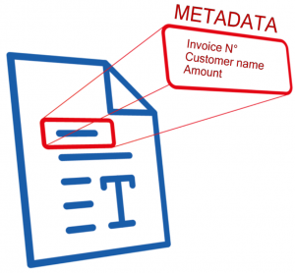
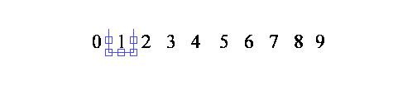
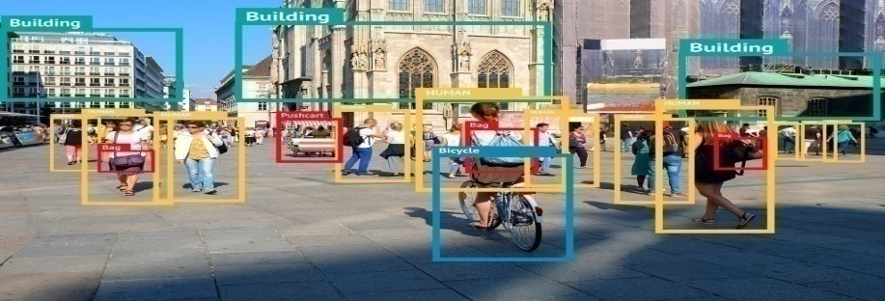
Application
Number recognition is known as pattern recognition is used in any area of science and engineering that studies the structure of observations. It is now frequently used in many applications in manufacturing industry, healthcare, and the military. These are the applications of this, Number recognition, Image identification, Document recognition system, ID & Digit or letter recognition etc.

Slide 5
Limitation
• Number recognition process is quite complex and lengthy, which consumes time.
• The dataset needs to be large for accuracy.
• The logic is not certain of object recognition.
• We have to search the numbers one by one.
• Multiple numbers can’t be searched by this code.

Slide 6
Framework
Start
Reading candidate and numbers template individually
NCC of binary image of candidate image
NCC of binary image of numbers template
RGB to gray conversion of candidate and numbers template
individually
Normalized cross co-relation between two normalized images data
Finding two threshold values from these two gray images individually
Identifying the proper numbers from the template (binary image)
Image to binary conversion of these two gray images according to the threshold values individually
Output
End

Slide 7
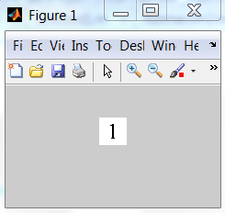
Processing Example
1. Candidate number image is converted to binary image according to the threshold value.
Fig 0.1: Numbers candidate image (Converted to binary image)

Slide 8
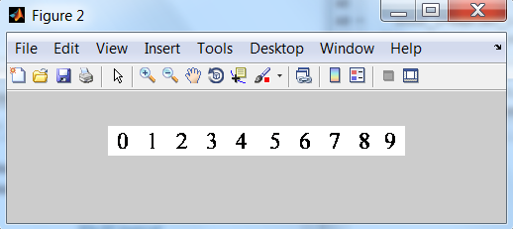
2. Numbers template is converted to binary image according to the threshold value.
Fig 0.2: Template (Converted to binary image)

Slide 9
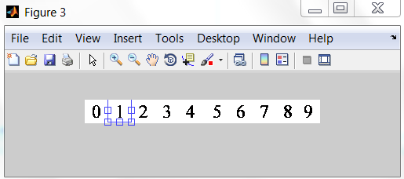
3. Template with matched pattern.
Fig 0.3: Template of Matched pattern

Slide 10
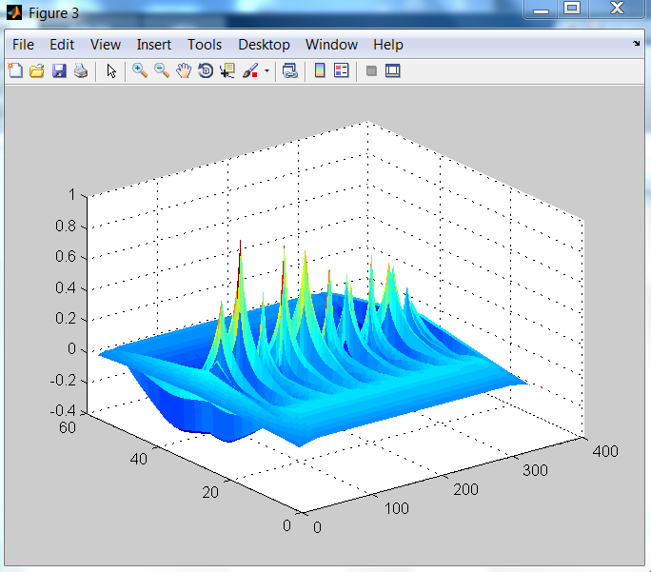
3. Diagram of template with matched pattern.
Fig 0.3: Histogram of template with matched pattern.

Slide 11
Conclusion
By this, we can identify the main pattern that means number, which we want to find from the template. Pattern recognition is now the most helpful system for daily life, Though it has some lacks, we can get more and more help for daily life or corporate life.
• Merits:
1. We can get the easy way to identify the required pattern (which is required to find out from template) output by using it.
2. It will be good for daily life to do task with doing another task.
• Demerits:
1. It is time consuming way sometimes.
2. Multiple numbers of patterns finding is not possible.

